Slide 1



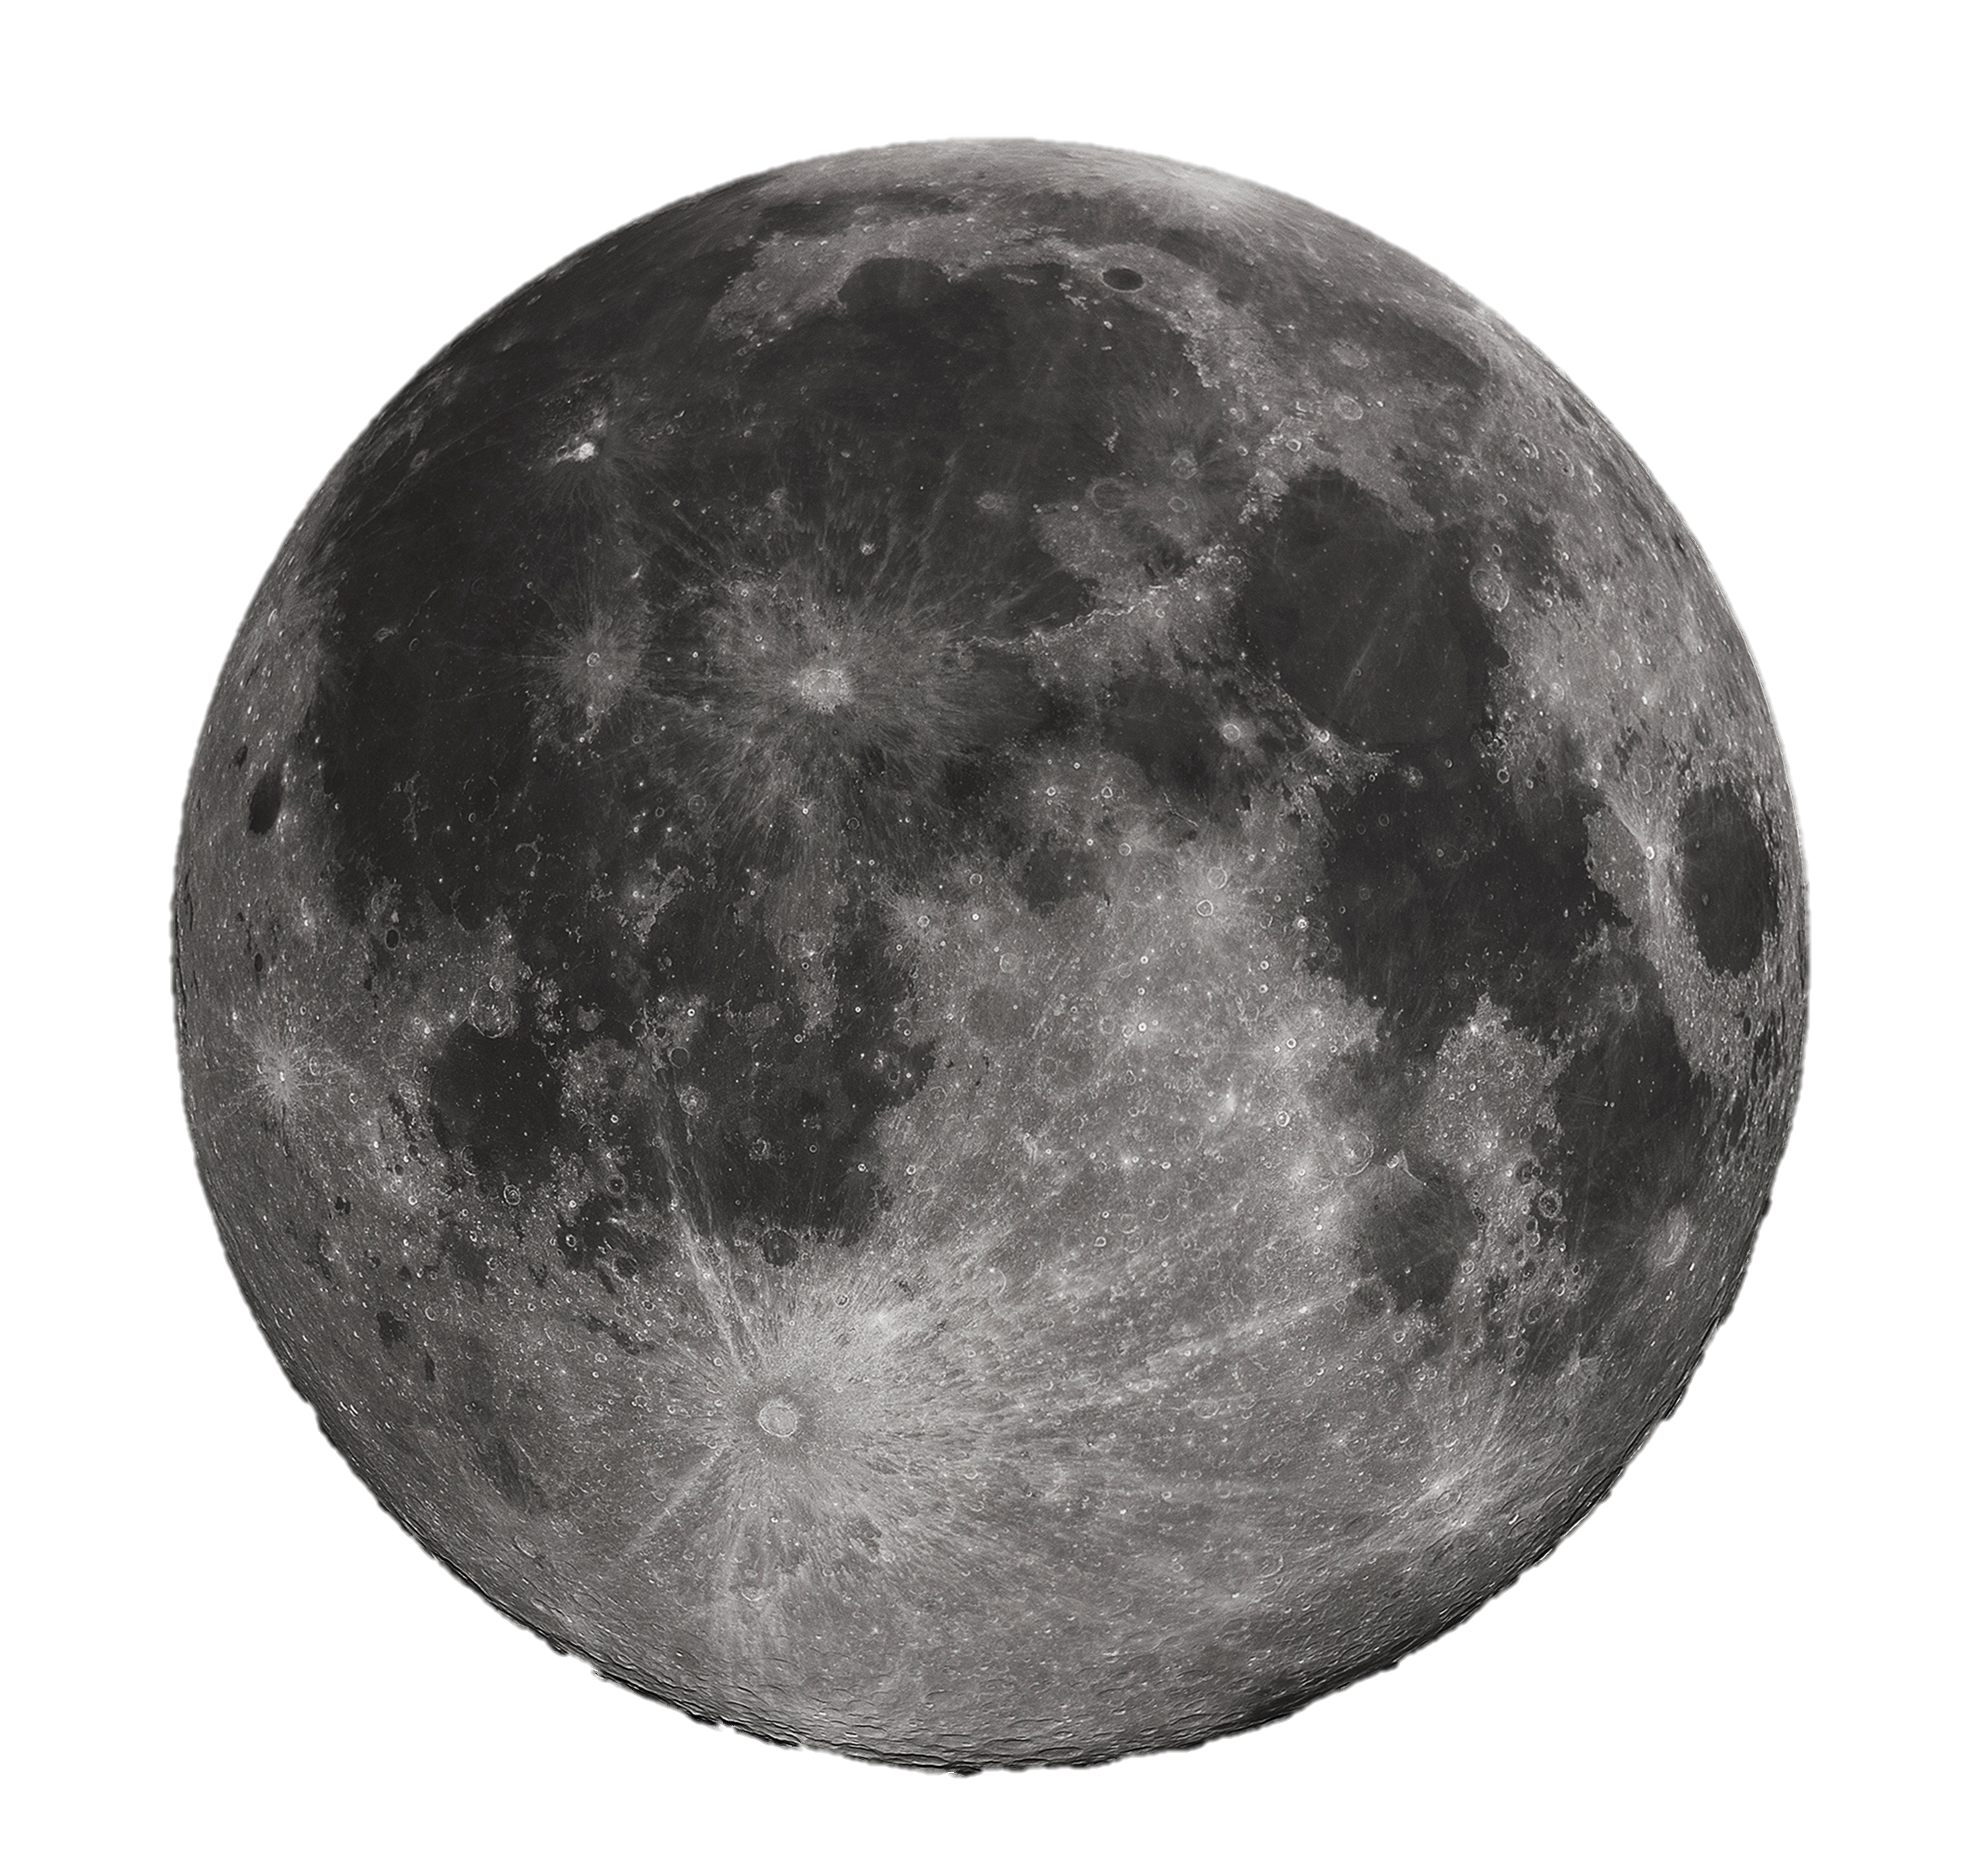



Space Force
Home Units About Us Recruitment Contact Us
Locations
75th Ranger Regiment selected as first recruiting pool for Space Force
The 75th Ranger Regiment is a lethal, agile and flexible force, capable of conducting many complex, joint special operations missions. Today's Ranger regiment is the Army's premier direct-action raid force. Each of the four geographically dispersed Ranger battalions is always combat ready, mentally and physically tough, and prepared to fight our country's adversaries. Their capabilities include conducting airborne and air assault operations, seizing key terrain such as airfields, destroying strategic facilities, and capturing or killing enemies of the nation. Rangers are capable of conducting squad through regimental-size operations and are resourced to maintain exceptional proficiency, experience and readiness. The regiment remains an all-volunteer force with an intensive screening and selection process followed by combat-focused training. The 75th Ranger Regiment is a proud unit and a team of teams - serving the nation..
Moon
Mars
Construction Underway
The construction of this new age branch has begun at Vandenberg, AFB. This California base is the current home of the Air Force Space Command and was determined to be the ideal location to facilitate the rapid creation of “The Space Force”.
Tatooine

Slide 2



Space Force
Home Units About Us Recruitment Contact Us
Locations
Moon
Colonial Forces
Pegasus Air Wing
Mars
Tatooine
The Argonauts
Advanced Tactical Training

Slide 3
Space Force
Home Units About Us Recruitment Contact Us
Locations
Moon
Mars
Tatooine

Slide 4

Space Force
Home Units About Us Recruitment Contact Us
Locations
Moon
Mars
Tatooine

Slide 5
Space Force
Mars Base X-2147
X-2147 is a premier research and development operating base. It features all the comforts of home minus comfortable outdoor weather, clean water or clean air.
The best part about mars……you can never leave

